Slide 1
TASK 1
Insights from Analyzing Customer Reviews for British Airways
Forage Data Science Project

Slide 2
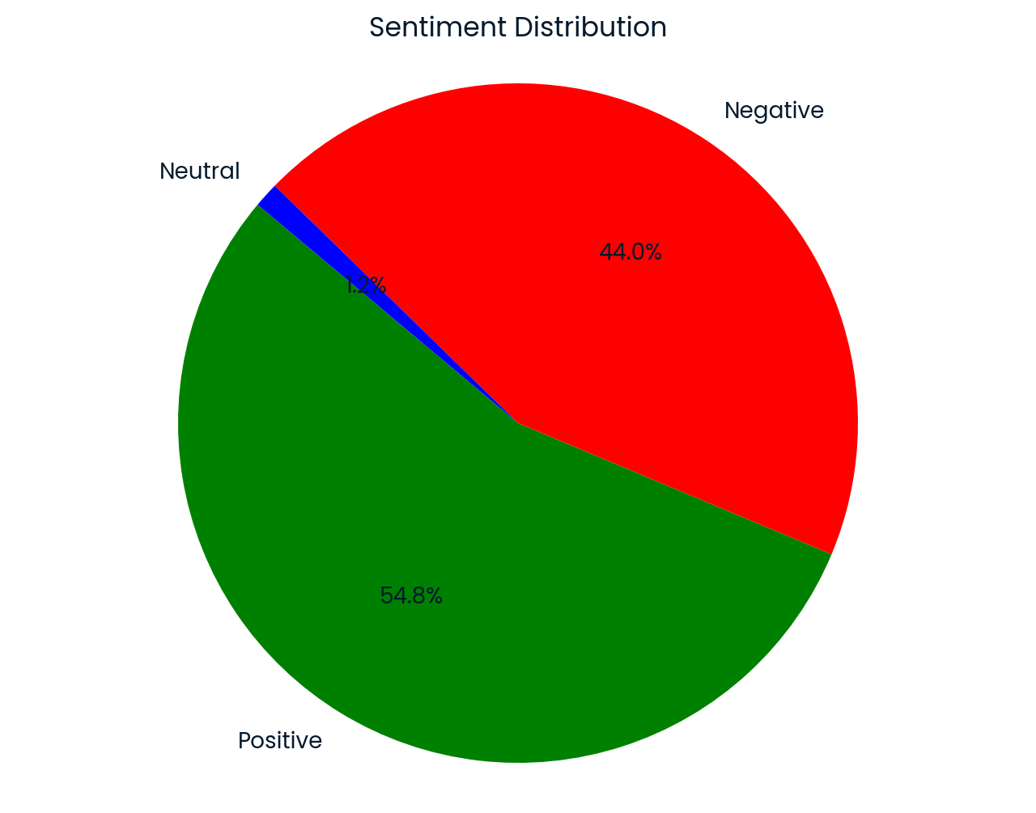
SENTIMENT DISTRIBUTION
Sentiment Insights (our of 1000 reviews): • Positive: 548 instances • Negative: 440 instances • Neutral: 12 instances
Most reviews for British Airways are positive, reflecting overall customer satisfaction. While there are some negative reviews, they are less frequent compared to the positive ones. Neutral reviews are rare, indicating that customers tend to have strong opinions.

Slide 3
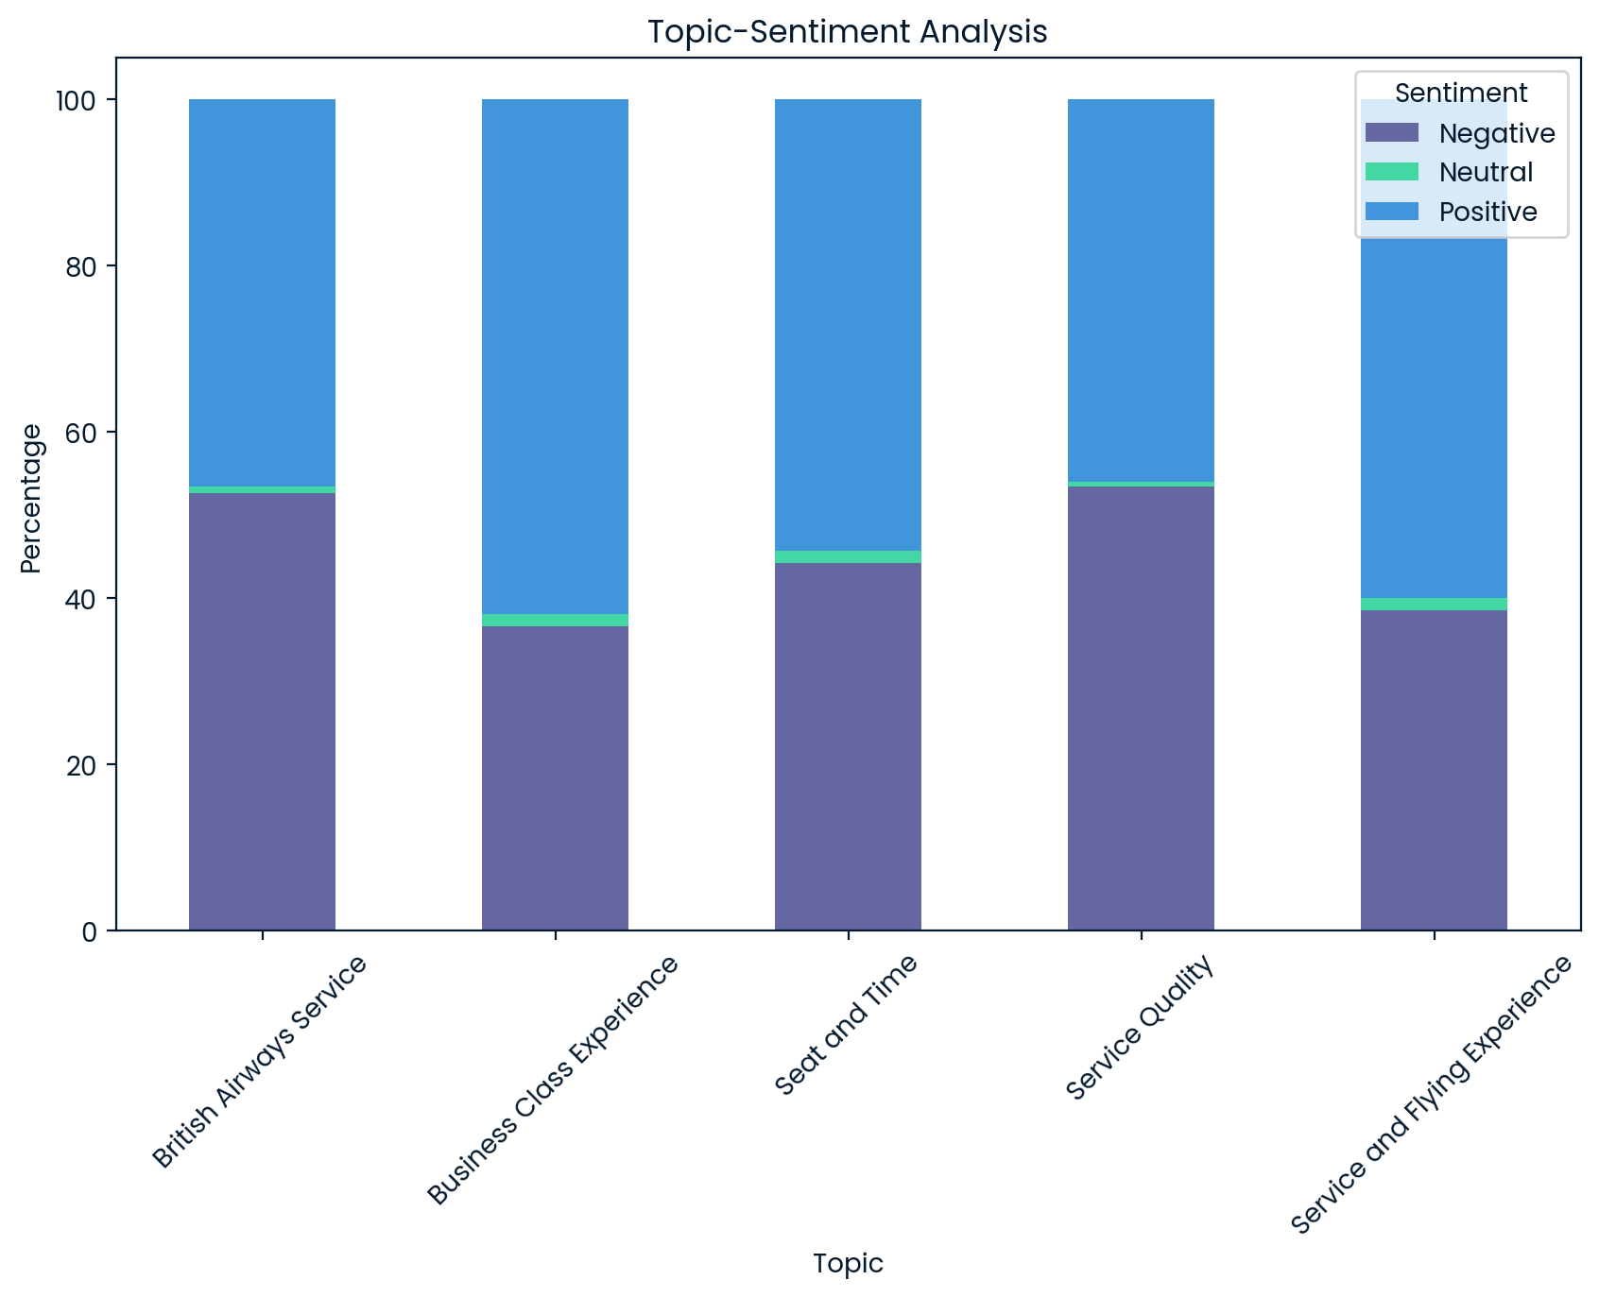
Topic-Sentiment Insights
Main Topics:
British Airways Service
Positive: 61
Negative: 69
Neutral: 1
Business Class Experience
Positive: 120
Negative: 71
Neutral: 3
Seat and Time
Positive: 113
Negative: 92
Neutral: 3
Service Quality
Positive: 86
Negative: 100
Neutral: 1
Service and Flying Experience
Positive: 168
Negative: 108
Neutral: 4

Slide 4
Topic-Sentiment Insights
The overall feedback reveals a mixed but predominantly positive perception.
The Business Class Experience and Service and Flying Experience categories stand out with the highest number of positive reviews, indicating strong customer satisfaction in these areas. However, negative sentiments are notably present across all aspects, with Service Quality receiving the most criticism. Neutral reviews are minimal, suggesting that customers generally express clear opinions.

Slide 5
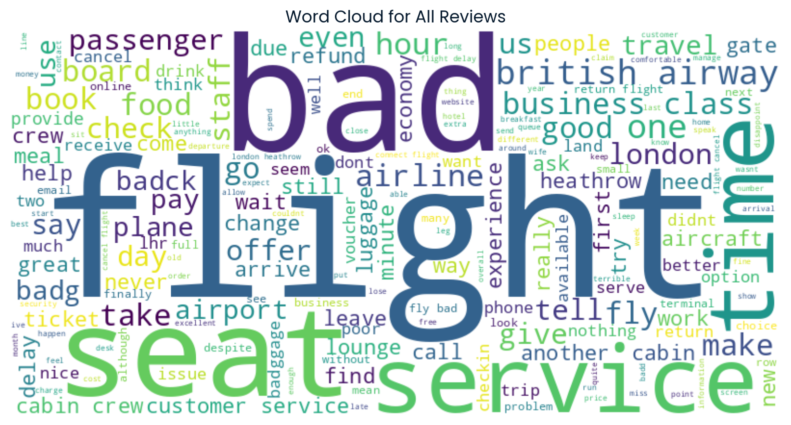
Word Cloud
The word cloud visually represents the aggregate feedback from our customers, highlighting common themes and sentiments.
Each word reflects an individual viewpoint, helping us gain a deeper understanding of the customer experience.

